Slide 1
Design & Develop Online Application For Retail
Kunanon Pititheerachot

Slide 2
Research Project Contents
Develop online web application
Information overload issue
Recommendation system
Content-Based recommendation
Purchase history
Addition
Rating,
Visiting history,
Keyword search method
Notes:
Addition
to enhance recommendation system I also expand this method by using Rating, visit history, keyword search to get more useful and improve web app

Slide 3
Research Project Contents
Develop online web application
Information overload issue
Recommendation system
Content-Based recommendation
Purchase history
Addition
Rating,
Visiting history,
Keyword search method
Interactive interface.
Visualization of order processing.
Online payment methods.
Orders generator.

Slide 4
Research Project Contents
Develop online web application
Information overload issue
Recommendation system
Content-Based recommendation
Purchase history
Addition
Rating,
Visiting history,
Keyword search method
Affect to everyone that using internet.
Obstacle user to reach desired product.
Notes:
This kind of online business has rapidly increasing growth rate as we can see some of giant ecommerce website such as Amazon, eBay, Alibaba have expanded their services and products continuously. These online retailers are growing bigger and bigger in every area of their own services and which means they are providing more choices of products to their customer in order to satisfy their audiences.

Slide 5
Research Project Contents
Develop online web application
Information overload issue
Recommendation system
Content-Based recommendation
Purchase history
Addition
Rating,
Visiting history,
Keyword search method
Assist user to reach product quicker.
Increase chance of sale.
Random items in the same category based on latest purchased product.
Notes:
The recommendation system is one of the most essential technique for online retailers that it provides suitable and properly service which help both customer and seller to reach their own goals.

Slide 6
Research Project Contents
Develop online web application
Information overload issue
Recommendation system
Content-Based recommendation
Purchase history
Addition
Rating,
Visiting history,
Keyword search method
Rating by other users.
Page counter.
Notes:
Keep visiting record by using page counter.

Slide 7
Prototype Features
Products
Search function
Recommendation System
Cart
Checkout
Account
Admin zone
Etc.
Notes:
Visualization of order processing
Generate order detail to database

Slide 8
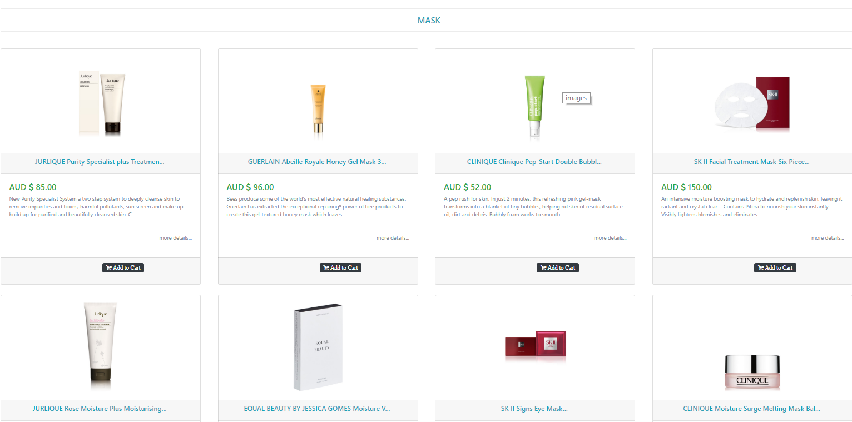
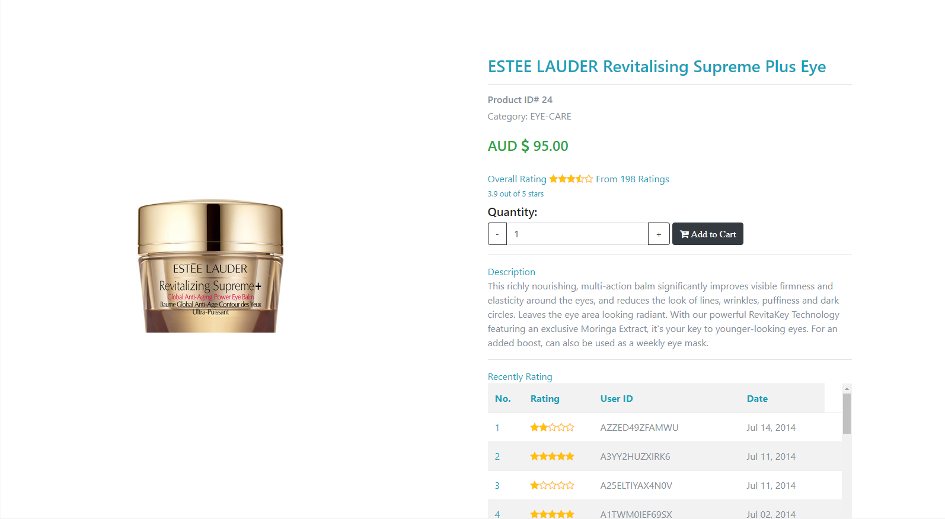
Prototype Features
Products
Catalogues
Product details

Slide 9
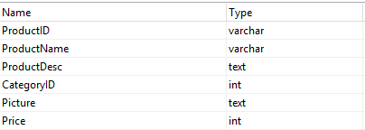

Prototype Features
Products
Database
Products
Category

Slide 10
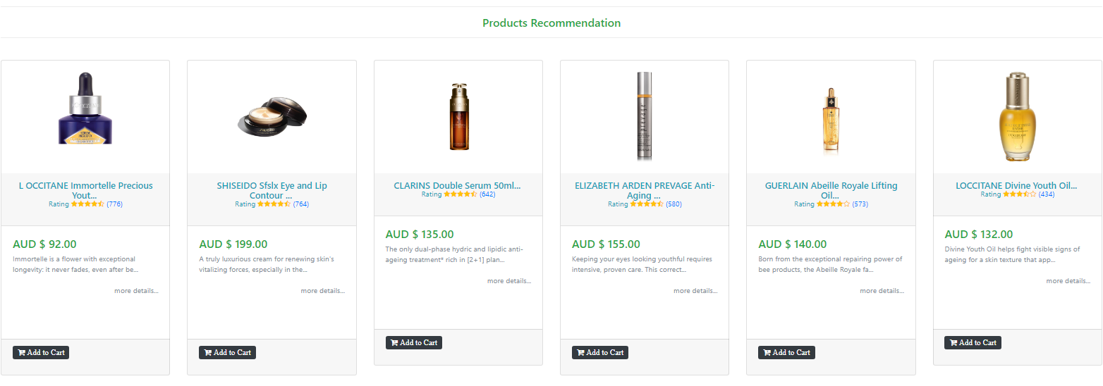
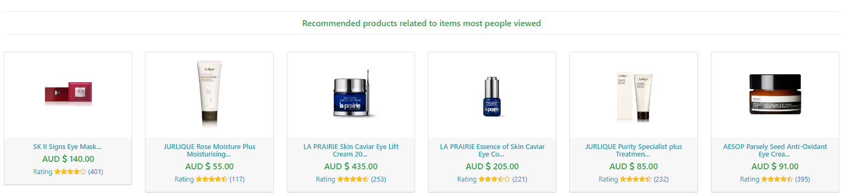
Prototype Features
Recommendation System
Purchase history
Visiting history
Rating

Slide 11
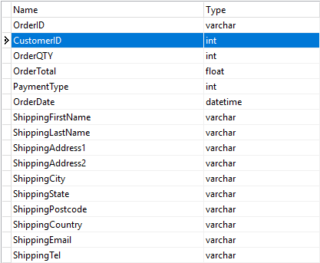
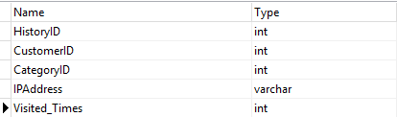
Prototype Features
Recommendation System
Purchase History
Visiting History

Slide 12
Recommendation System Algorithm
Customer ID
Purchase History Table
Category ID
Purchase History Table
Rating
Product Table
Recommend Products

Slide 13
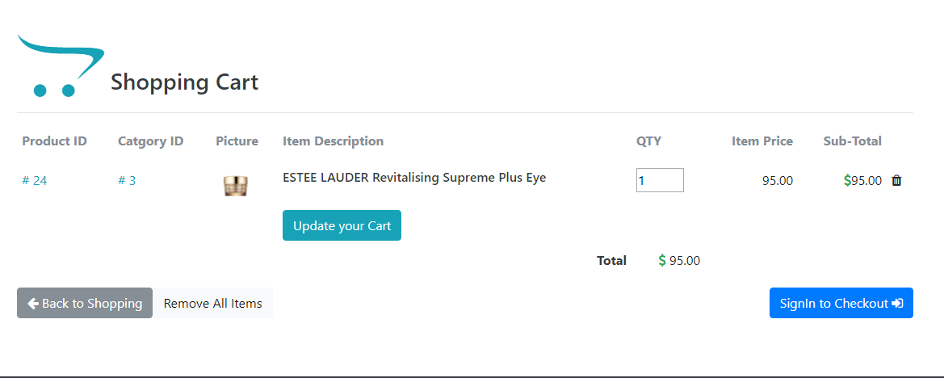
Prototype Features
Cart
Session
Notes:
Destroy when logout and finish checkout

Slide 14
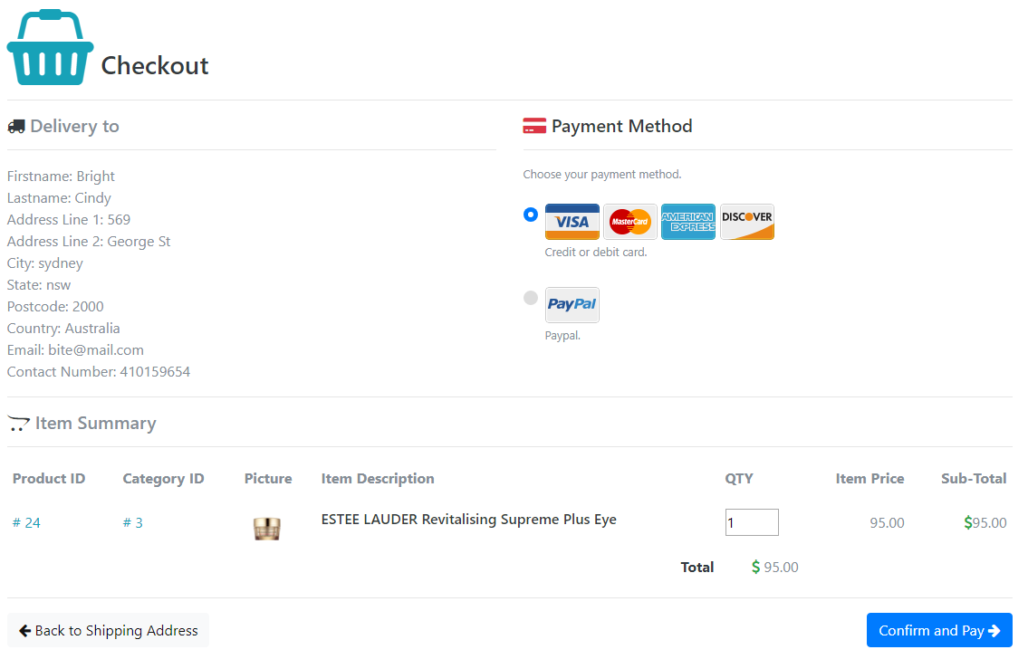
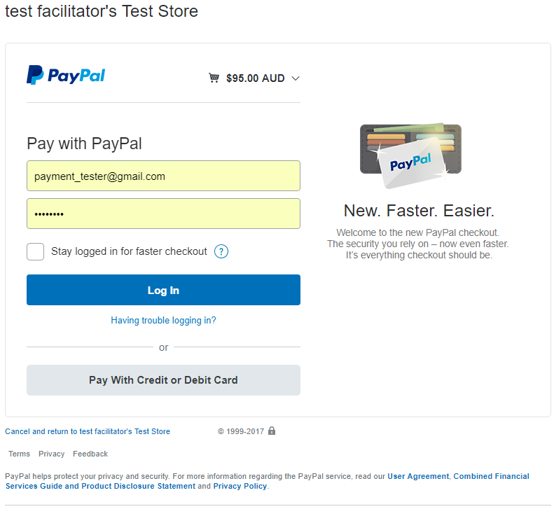
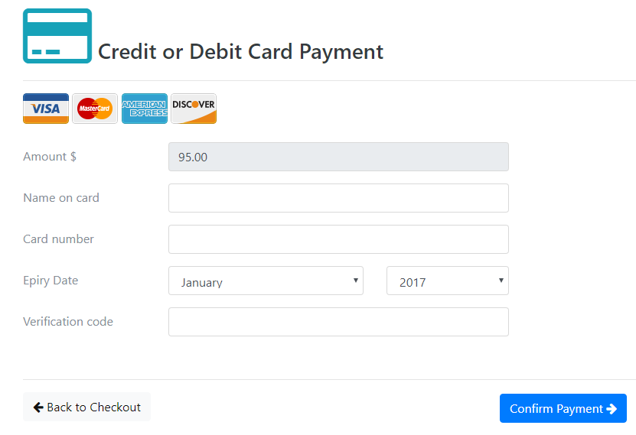
Prototype Features
Checkout
Credit card payment method.
PayPal payment method.
Generate order detail.

Slide 15
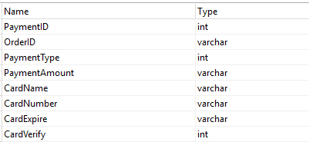
Prototype Features
Checkout
Credit card payment method.
PayPal payment method.
Generate order detail.

Slide 16
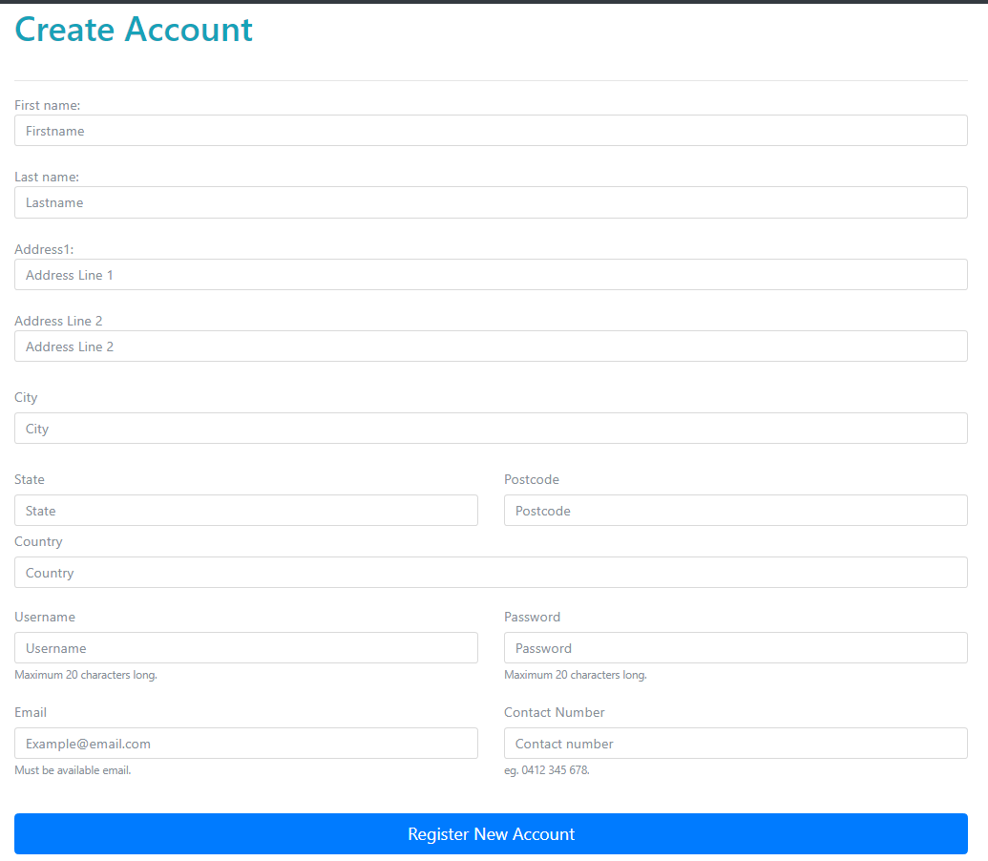
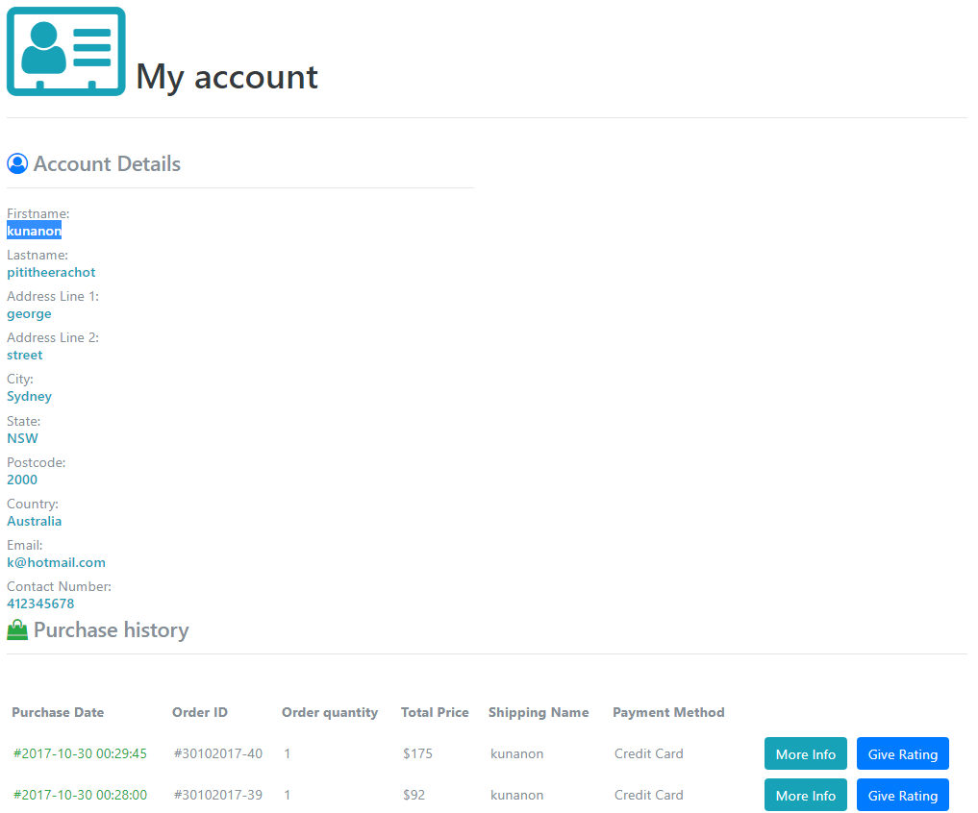
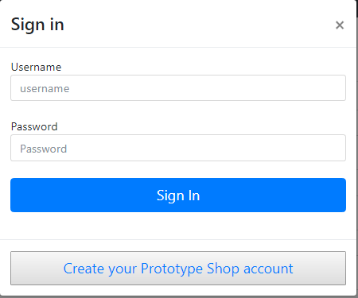
Prototype Features
Account
Register
Sign In / Sign Out
Account management

Slide 17
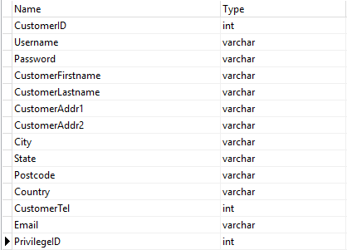
Prototype Features
Account
Register
Sign In / Sign Out
Account management

Slide 18
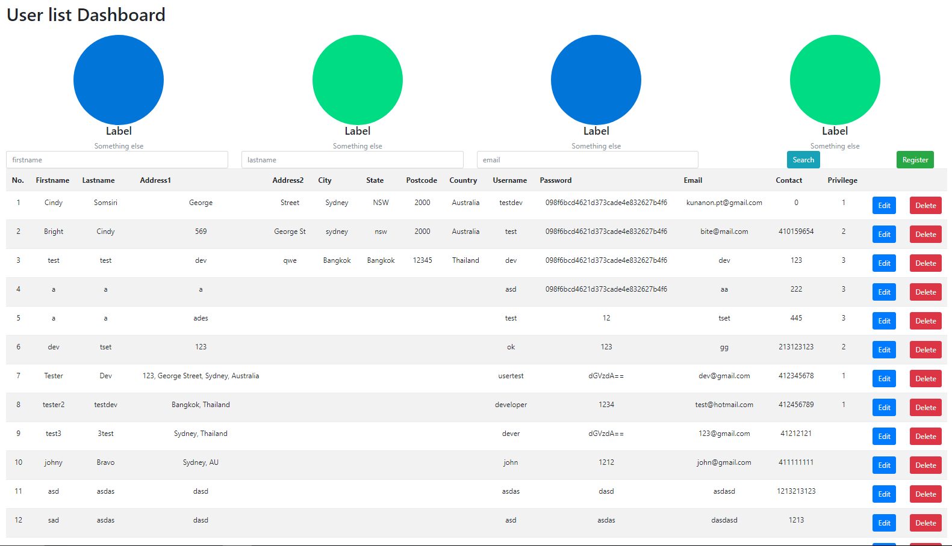
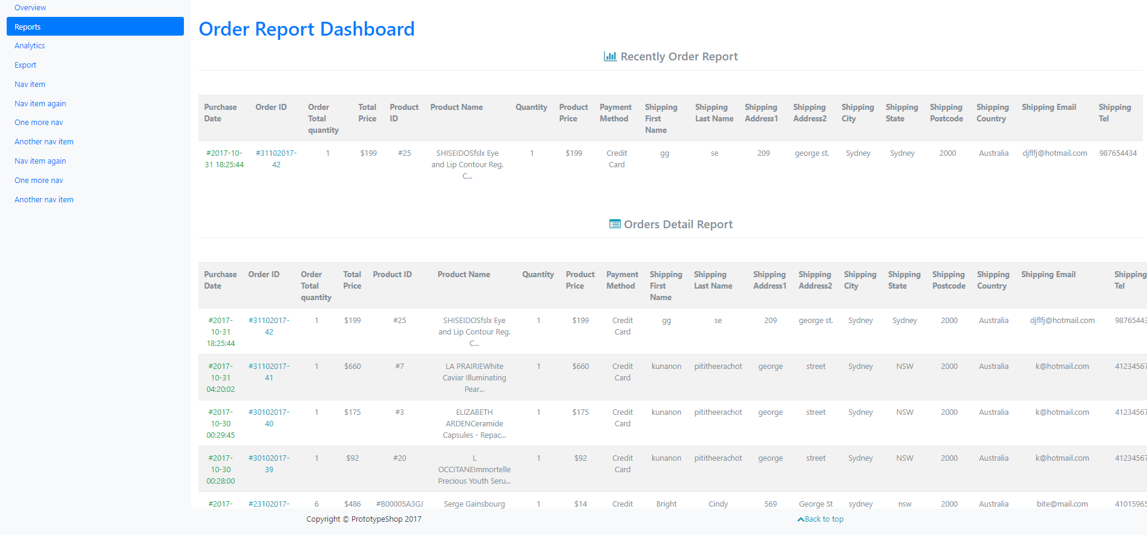
Prototype Features
Admin zone
Add
Edit
Remove
Report

Slide 19
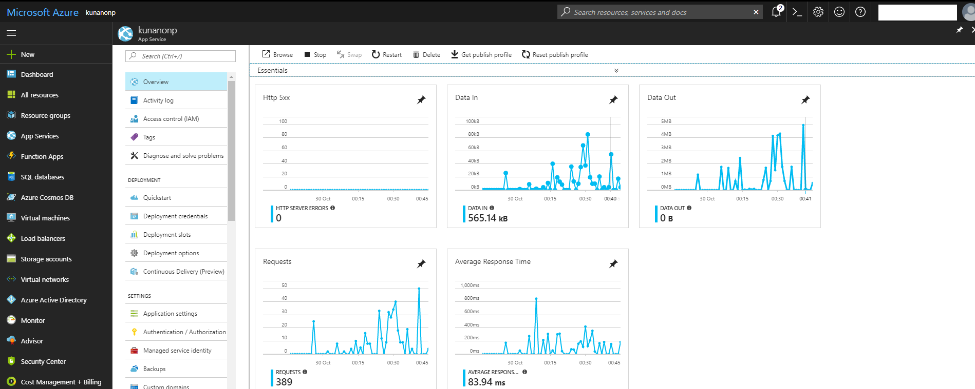
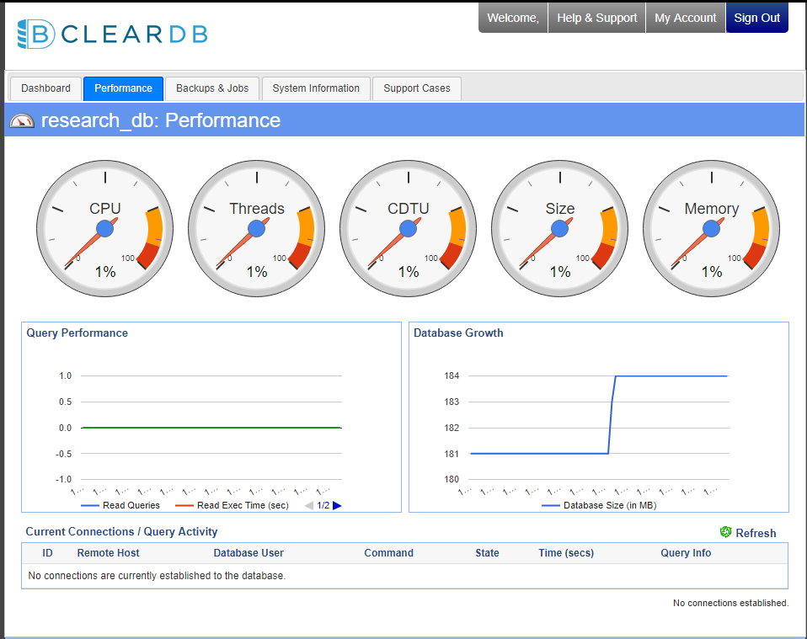
Prototype
- Azure cloud service
ClearDB database
http://kunanonp.azurewebsites.net/
Notes:
Deploy website on Azure cloud service from Microsoft
ClearDB database for storing data using MySQL database

Slide 20
Evaluation
Test web application functions.
Attempt to make a purchase.
With different payment method (credit card and PayPal)
Attempt to create an account
Sign In
Sign Out
Attempt to add, delete, update product on cart.
Attempt to Search product.
Check rating contents in product page.
Check recommendation contents.
Check admin zone outcome.

Slide 21
Conclusion
Web application for retail
Content-based recommendation
Performance
Future work
Collaborative recommendation system
API
Admin zone functions
Notes:
Web application for retail
Content-based recommendation for solving information overload and add rating, visitor history, search for more benefit.
Performance depends on number of records in free tier of azure should not exceed more than 1k
API for allow other device such as mobile to connect to the web application service
Admin zone functions such as live chat, purchase and transaction monitoring service.

